Slide 1
Tour Mate
Moblie Application Development
BITM Final Project

Slide 2
Group Members:
Md. Rahamat Ullah
Shuva Ranjan Rishi
Md. Harun or Rashid
Email : uahamat01@gmail.com
FaceBook: facebook.com/urahamat01
SEID: 268565
Email: shuvaranjanrishi@gmail.com
FaceBook: shuvaranjanrishi/facebook.com
SEID : 270318
Email : harunk873@gmail.com
FaceBook: harun.khan/facebook.com
SEID: 255700

Slide 3
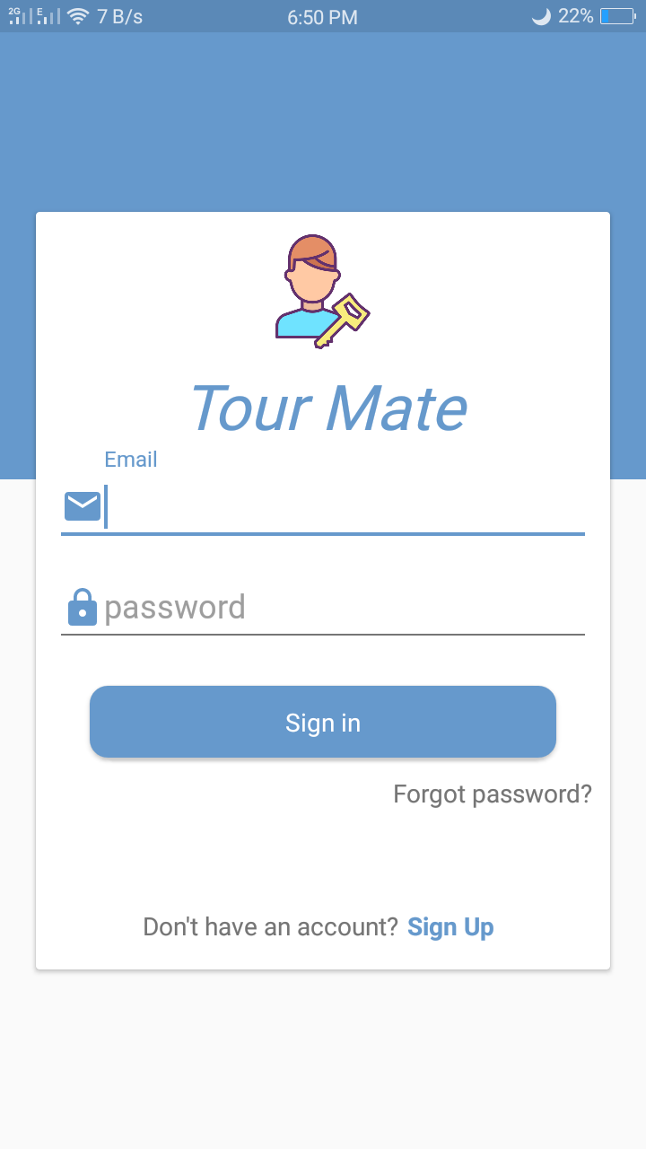
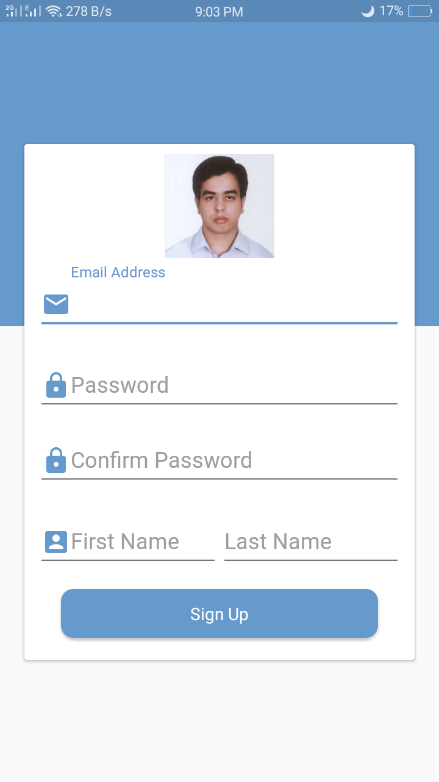
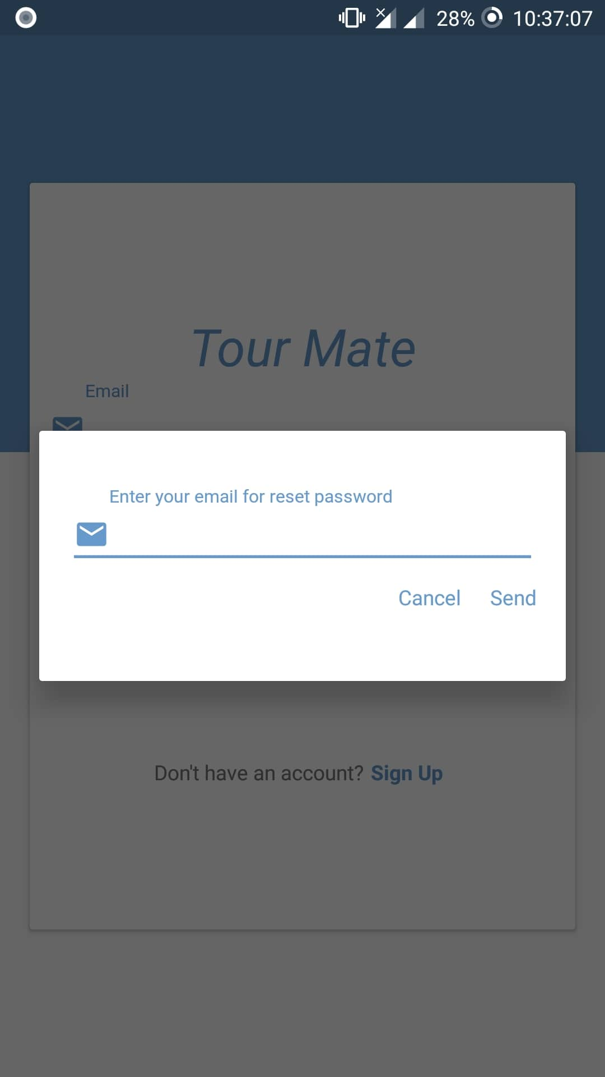
SignUp and SignIn:
1.Signin
2.Signup
3.Forget password

Slide 4
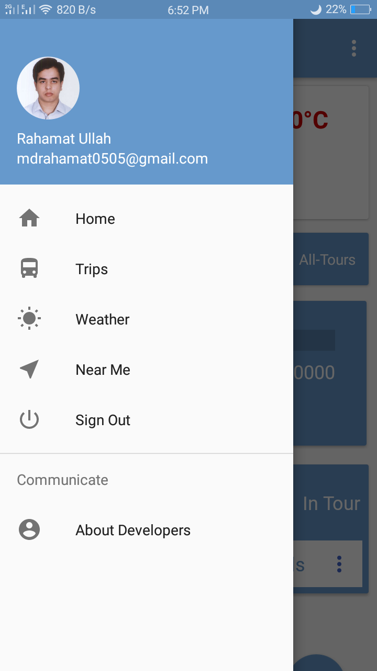
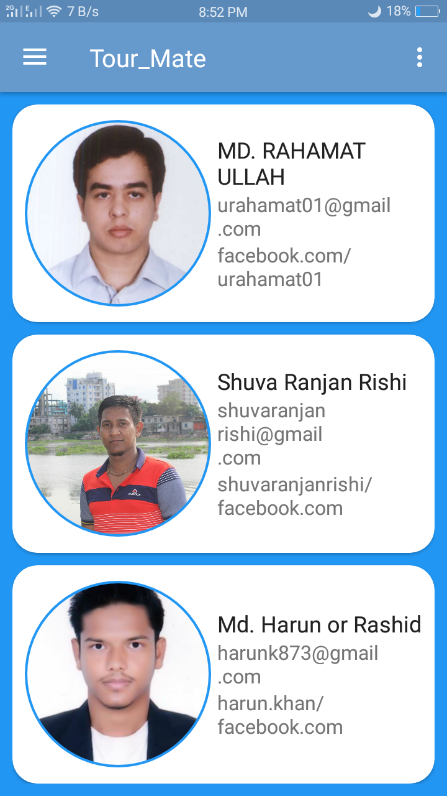
Drawer:
User profile photo
User name and email
Trips
Weather
Near me
Sign Out

Slide 5
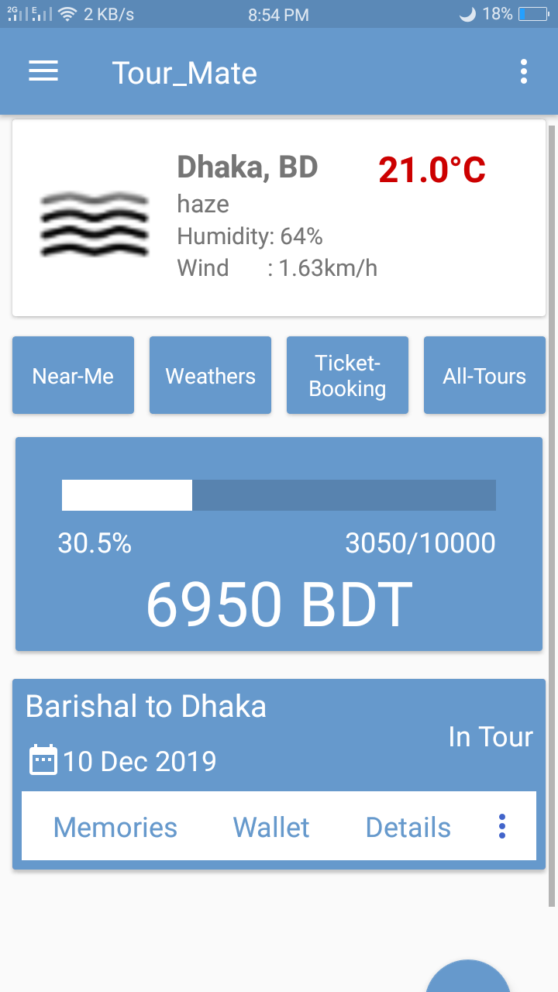
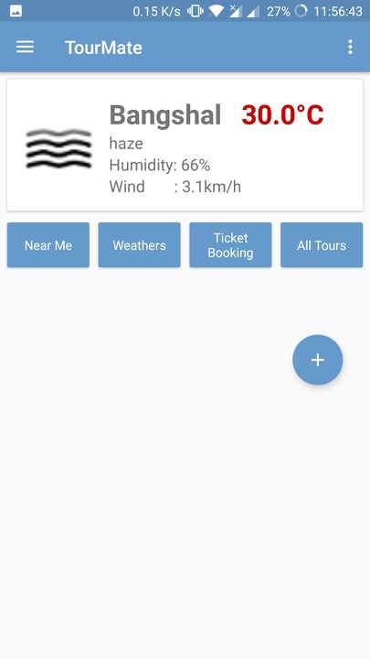
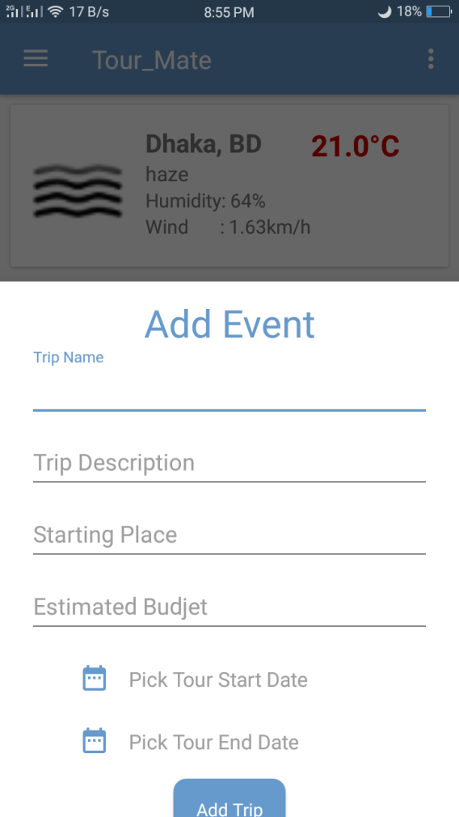
Dashboard
Current Weather
Current Trip
Expense amount

Slide 6
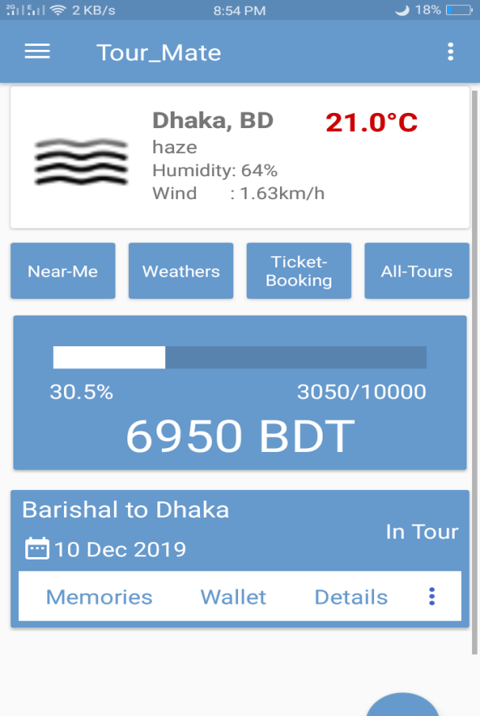
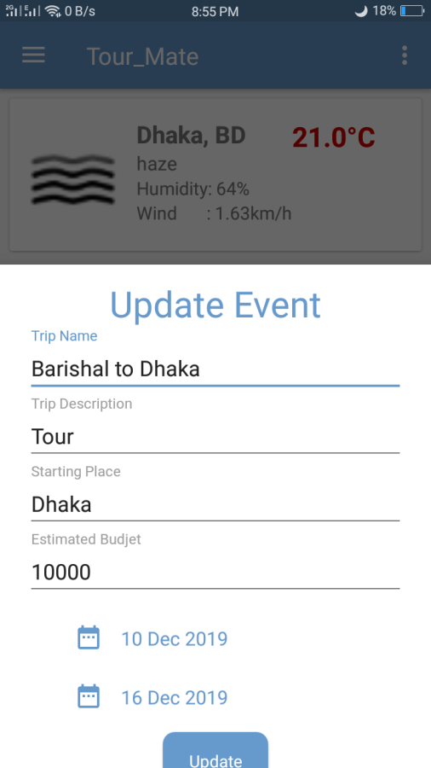
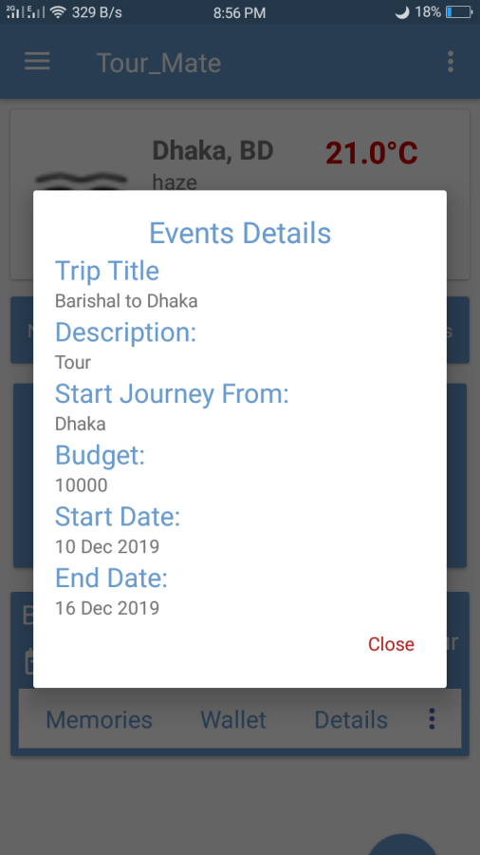
Trips activity:
Update
Delete
Details
Add expense
Add memory

Slide 7
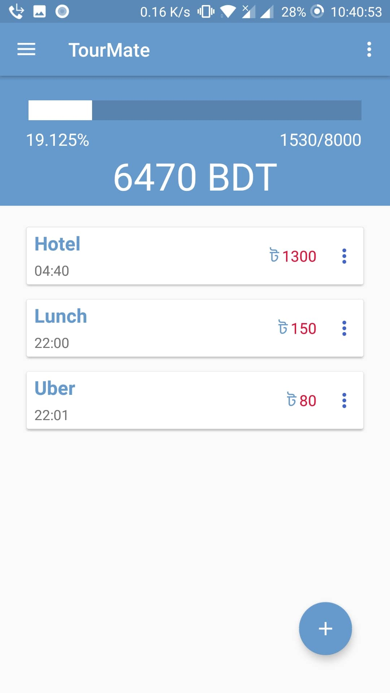
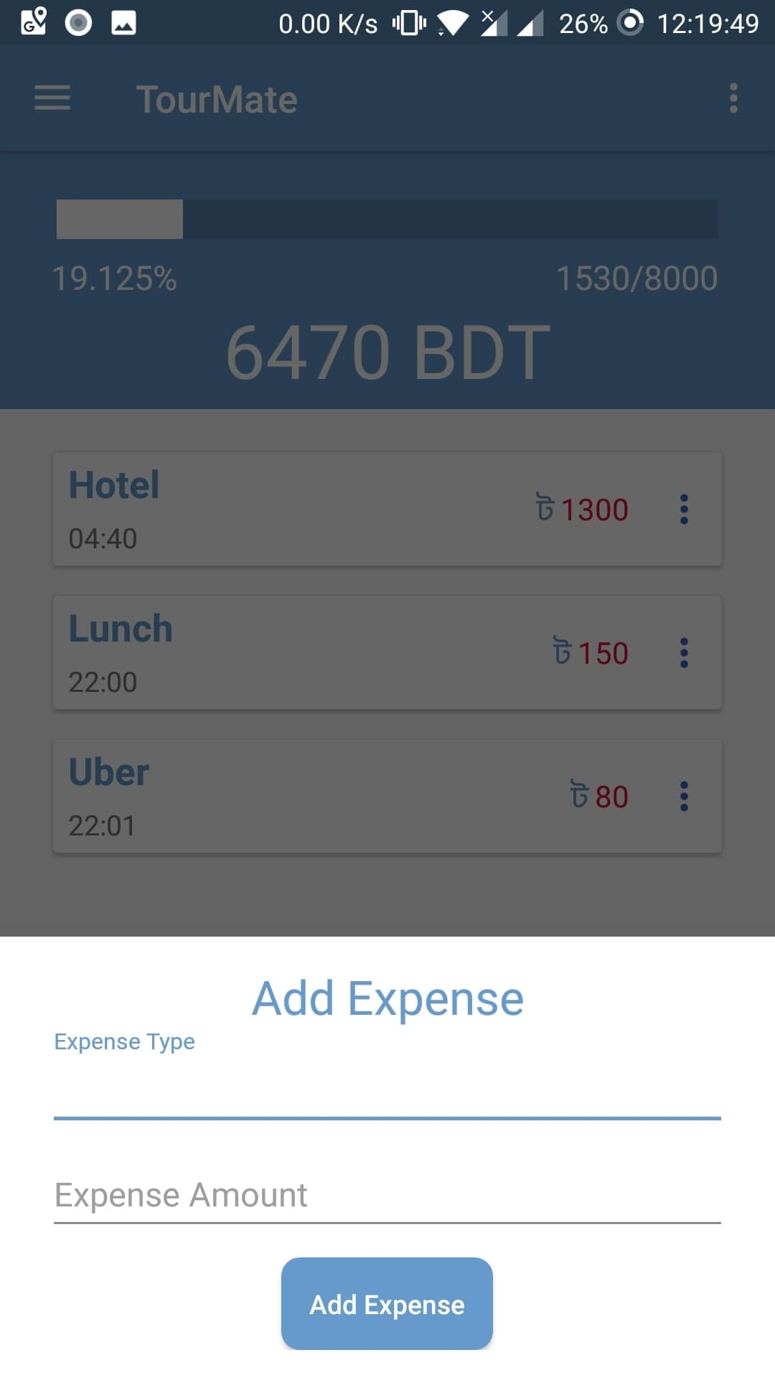
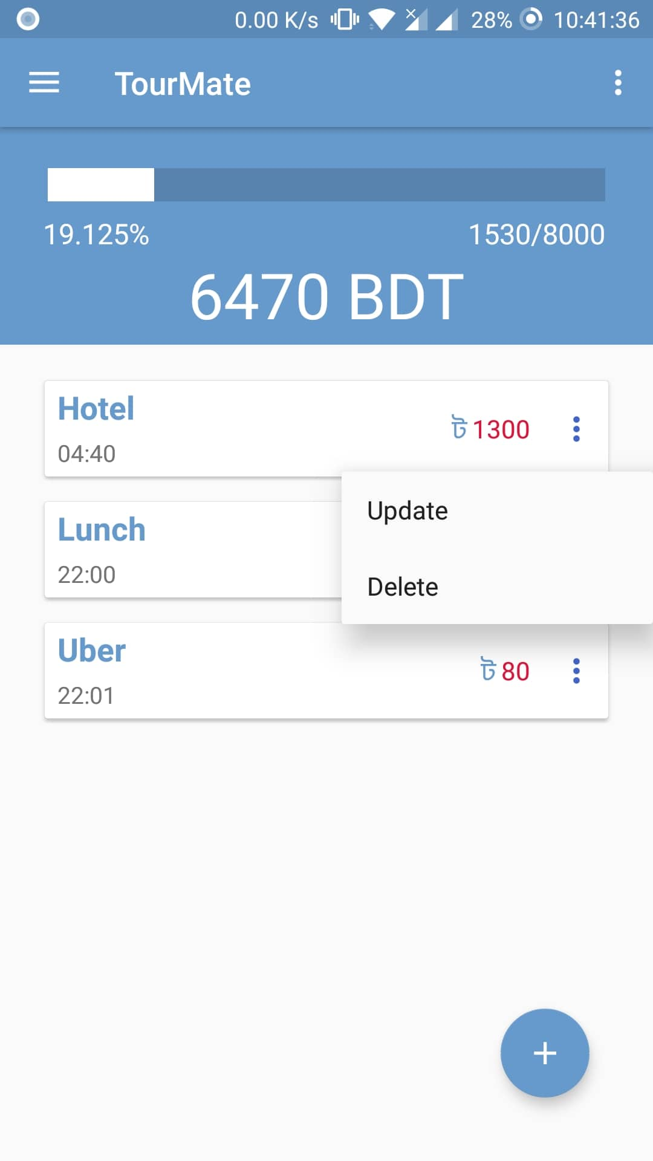
Wallet:
Current Balance
Total expense
Graphical view
Total Budget
Add Expense
Update Expense
Delete Expense

Slide 8
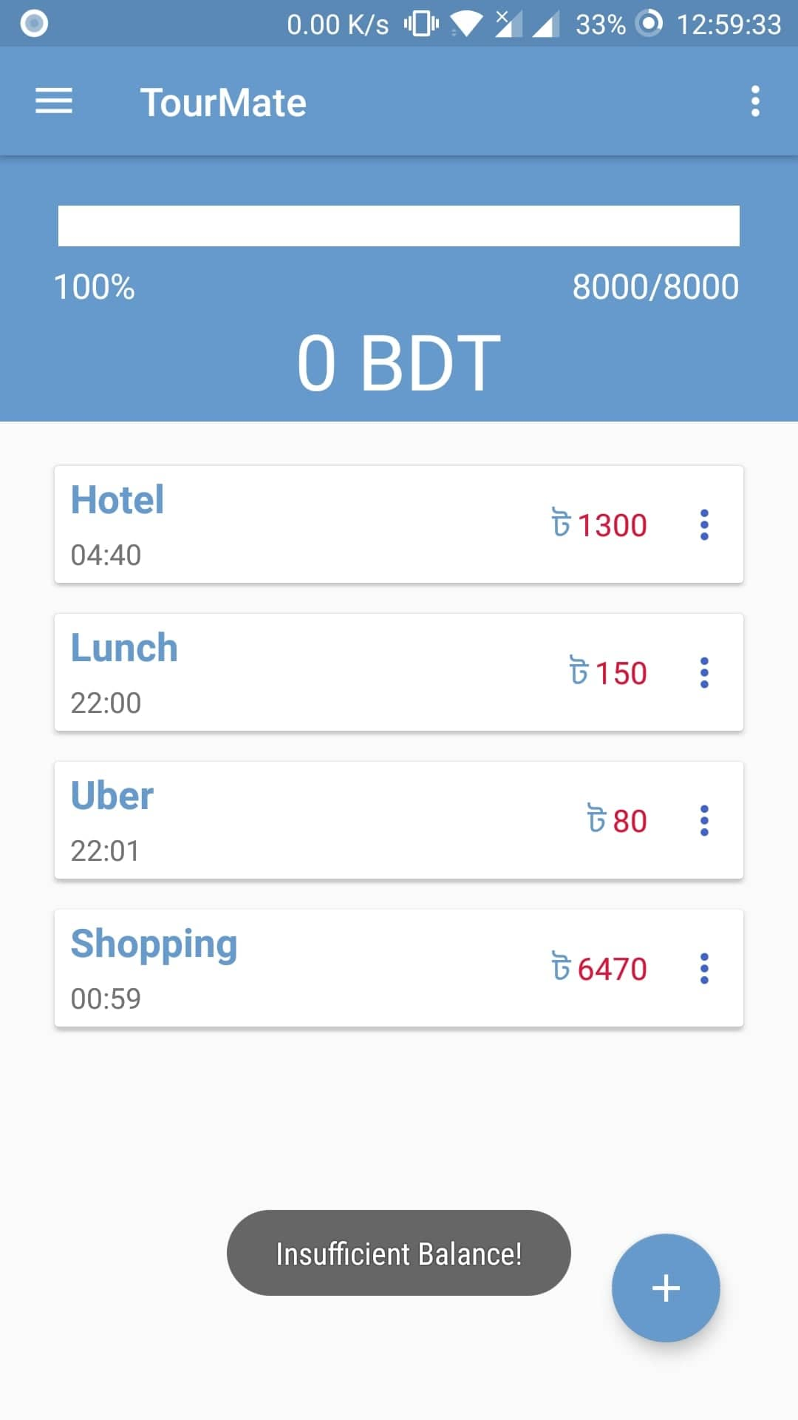
Balance Maintain:
Cant add expense when balance zero

Slide 9
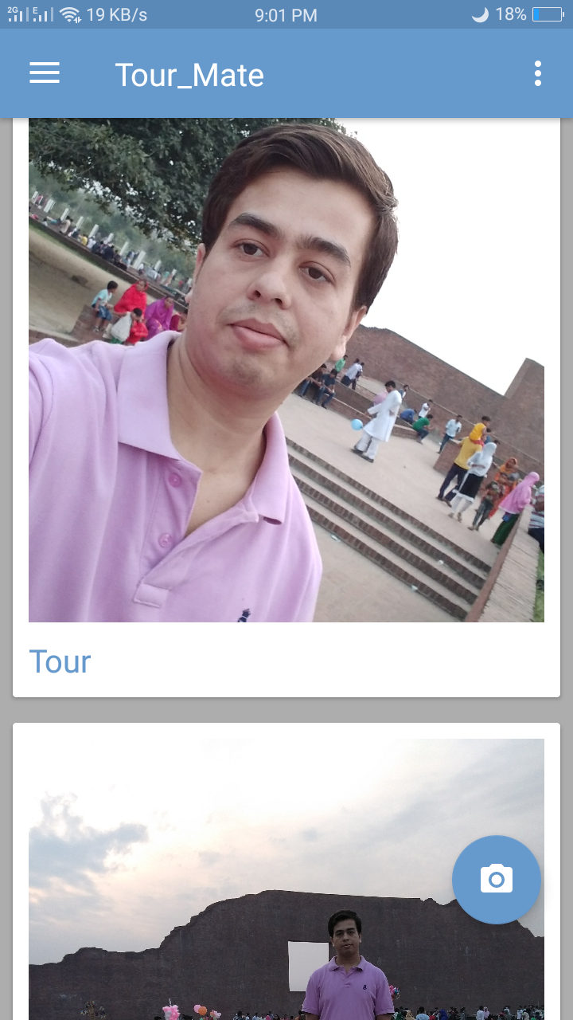
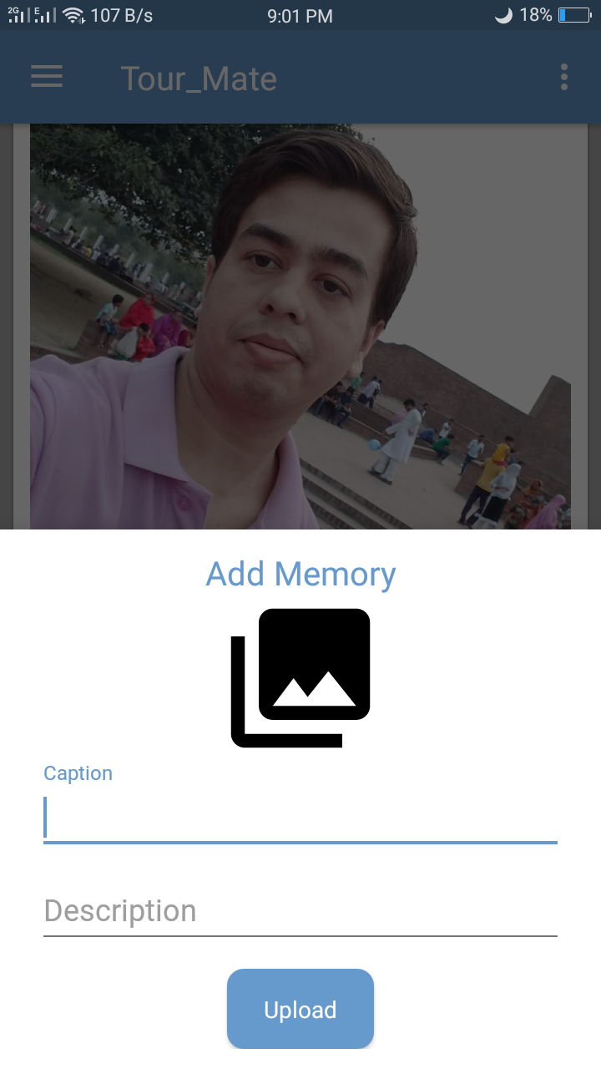
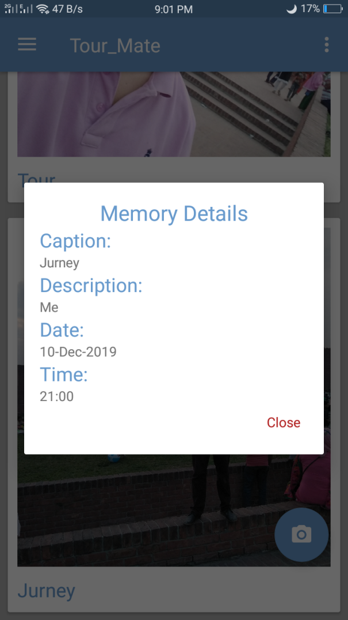
Memories:
Add memory
Details memory
Show memory

Slide 10
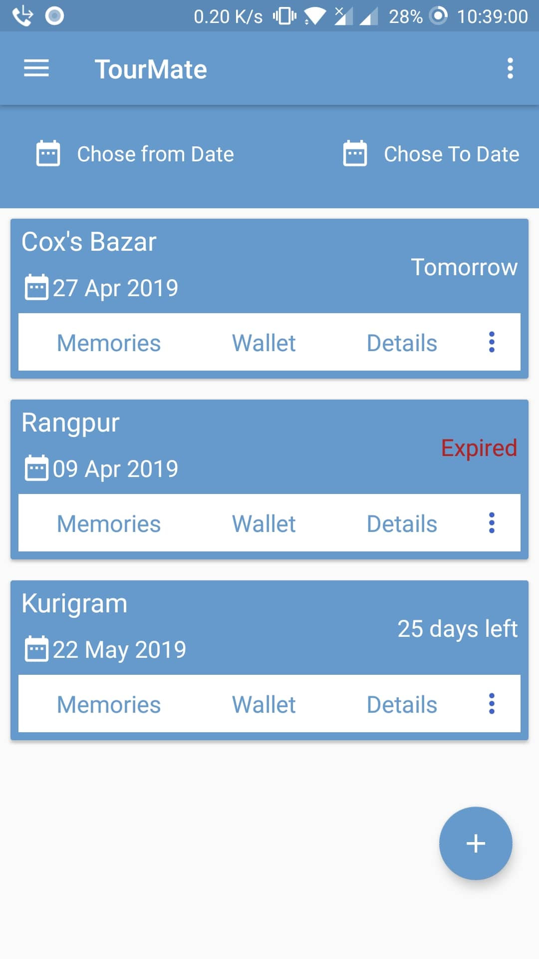
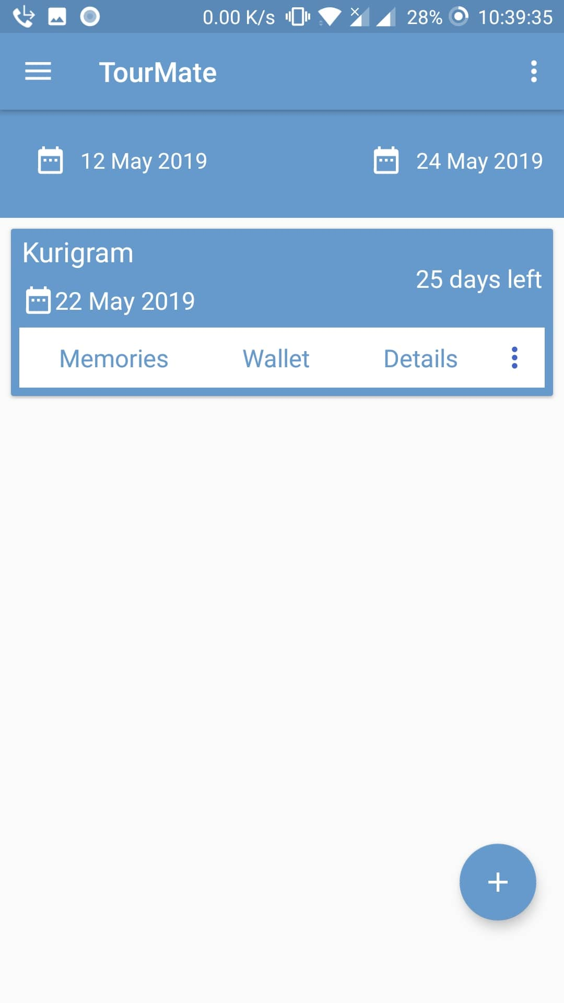
Trips History:
Filtering trips
Show the status of the trips
Add Trip

Slide 11
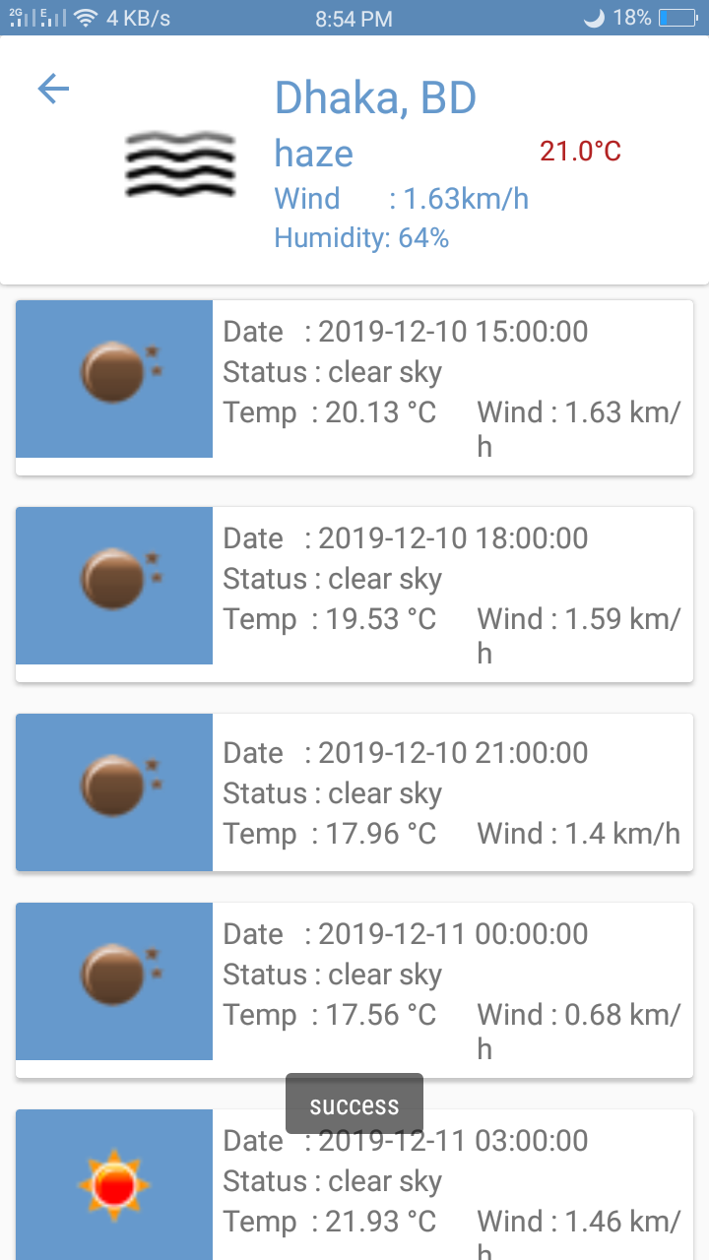
Weather:
Current Weather
5 days weather forcast

Slide 12
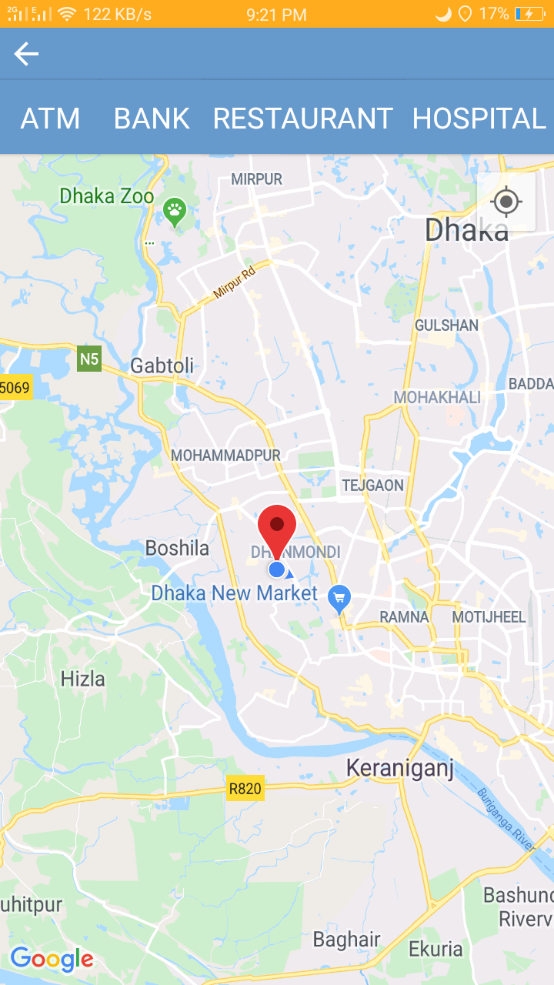
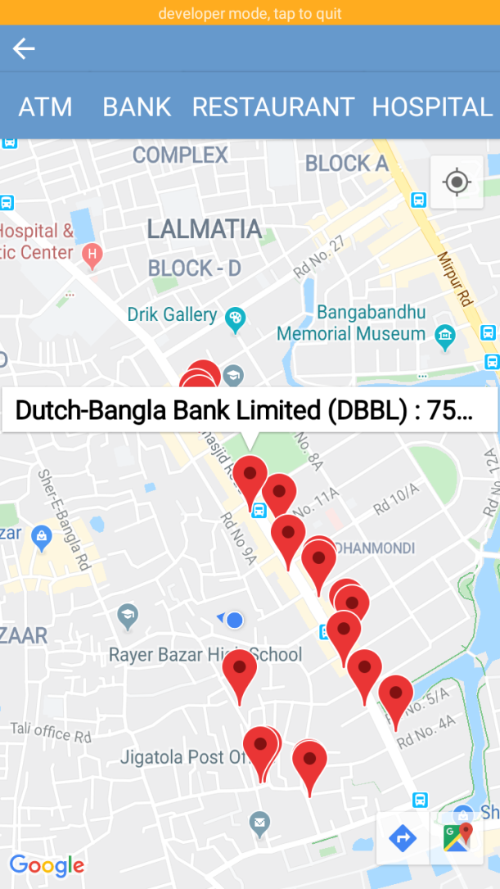
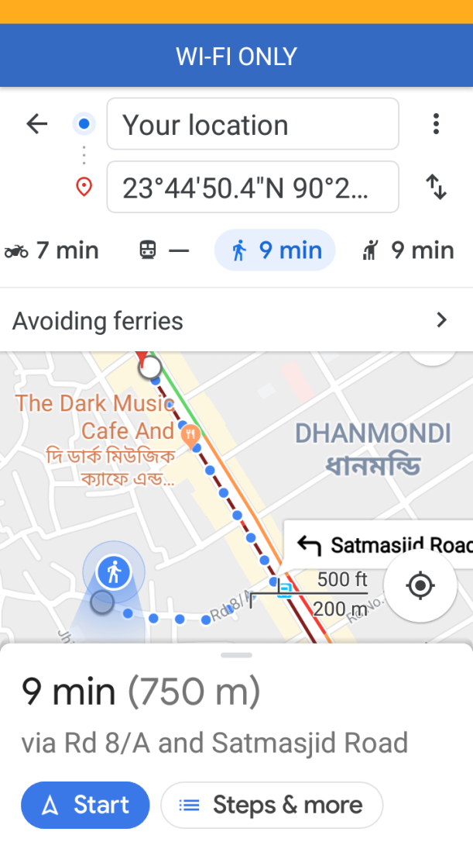
Map:
Current Location
Nearby places
Direction
Information

Slide 13
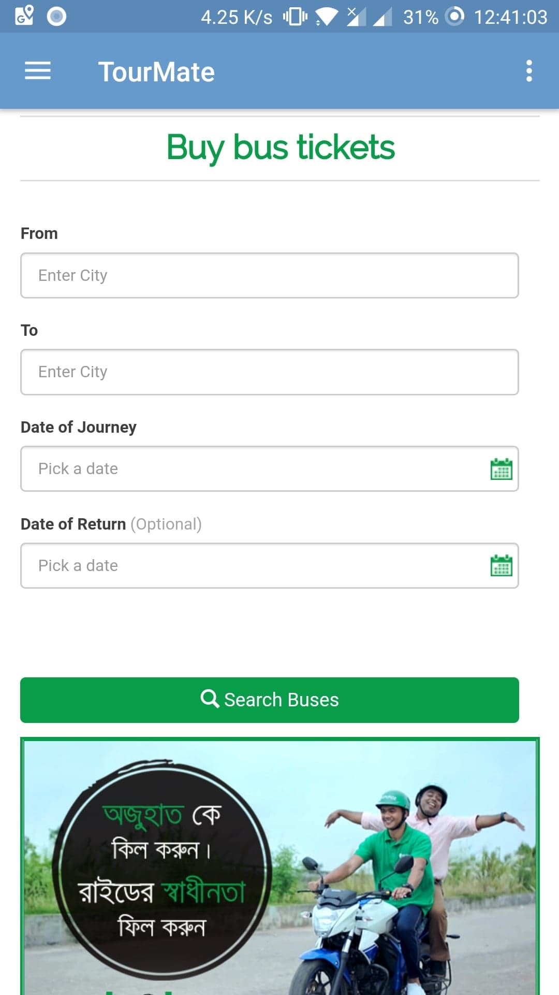
Ticket Booking:

Slide 14
Thank You ☺

